Slide 1



27 October 2026
Project Phase-I Review-I
27 October 2026
Paper Title: A Web-Based Student and Teacher Portal for
Academic Management
Presented by:
Mr. Ismail Fazal Mahmood Khan Mr. Gulam Mohammed
Mr. Mohammed Adeeb ur Rahman
Under the Guidance of
160923737037
160923737047
160923737060
Mr. Siva Rama Krishna, Assistant Professor

Slide 2
TABLE OF CONTENTS
27 October 2026
Abstract
Introduction
Literature Survey
Summary of Literature
Existing System
Limitations of Existing System
Proposed System
Problem Statement
Objectives
Advantages of Proposed System
Methodology
System Architecture
Techniques
Datasets
Implementation
Results
Conclusion
Reference

Slide 3
ABSTRACT
27 October 2026
Schools and colleges still manage attendance, marks and messages by hand.
This project builds one web portal for Admin, Teachers and Students.
Teachers add attendance, assignments, marks and study materials.
Naïve Bayes and XGBoost study the marks and predict Good, Fair or Poor.
Parents get email updates and teachers can help weak students early.

Slide 4
INTRODUCTION
27 October 2026
Schools and colleges still track attendance, marks and messages by hand.
This project builds one web portal for students and teachers.
It has separate logins for Admin, Teachers and Students.
Teachers can add attendance, assignments, marks and study materials.
Machine learning (Naïve Bayes and XGBoost) studies the students' marks.
It tells each student if performance is Good, Fair or Poor.
This helps teachers give help early.

Slide 5
LITERATURE SURVEY
27 October 2026
Author / Year | Work | Technique / Focus | Limitation / Gap
Lau & Abdul Rahman, 2026 | XGBoost Study | XGBoost with oversampling to predict CGPA | No portal or messaging
Kate et al., 2026 | EduBoost Framework | XGBoost sorts students as low, medium or high | No dashboards
Nasril et al., 2026 | Naïve Bayes Study | Naïve Bayes classifies timely graduation | No portal or marks prediction
Proposed System | Student & Teacher Portal | Naïve Bayes + XGBoost | Prediction + full portal

Slide 6
SUMMARY OF LITERATURE
27 October 2026
Lau & Abdul Rahman (2026): XGBoost with oversampling was best at predicting CGPA, but there is no portal.
Kate et al. (2026): EduBoost (XGBoost) gives 95% accuracy for low, medium and high grades, but has no dashboards.
Nasril et al. (2026): Naïve Bayes classified graduation with 88.72% accuracy, but it is not a full system.
Common gap: prediction work and academic portals are kept separate.
This project joins both in one system.

Slide 7
EXISTING SYSTEM
27 October 2026
Attendance and marks are written in registers or Excel sheets.
Each teacher keeps records separately.
Students see results only after exams or on notice boards.
Messages to students and parents go by phone calls or paper notes.
Teachers find weak students only after final results.

Slide 8
LIMITATIONS OF EXISTING SYSTEM
27 October 2026
Manual work takes time and causes mistakes.
Records can be lost or changed by mistake.
No prediction of student performance.
Communication with students and parents is slow and poor.
No single place for study materials and assignments.
Weak students are found too late.

Slide 9
PROPOSED SYSTEM
27 October 2026
One web portal with separate logins for Admin, Teachers and Students.
Admin adds teachers and students.
Teachers add attendance, assignments, marks and study materials.
An ML model predicts performance as Good, Fair or Poor from marks.
Students see marks and feedback. Parents get emails.

Slide 10
PROBLEM STATEMENT
27 October 2026
Old student systems only store attendance and marks by hand. They cannot predict how a student will perform, and communication with students and parents is poor. This project builds a simple portal with machine learning to solve these problems.

Slide 11
OBJECTIVES
27 October 2026
Build one web portal for academic management.
Give Admin, Teachers and Students their own dashboards.
Reduce manual work in attendance and marks entry.
Predict student performance using Naïve Bayes and XGBoost.
Compare both models and choose the more accurate one.
Improve messaging between teachers, students and parents.

Slide 12
ADVANTAGES OF PROPOSED SYSTEM
27 October 2026
Saves time and reduces paperwork.
All records stay safe in one database.
Weak students are found early.
Students see marks and feedback instantly.
Easy sharing of study materials and messages.
Simple to use for everyone.

Slide 13
METHODOLOGY
27 October 2026
Admin Login & Setup: Admin adds teachers and students.
Teacher Login: Teachers log in with details given by admin.
Attendance & Assignments: Teachers add attendance, assignments and study
materials.
Marks Entry: Teachers enter marks for each subject.
ML-Based Prediction: The model marks performance as Good, Fair or Poor.
Feedback & Communication : Students see marks, feedback and messages; parents
get emails.

Slide 14

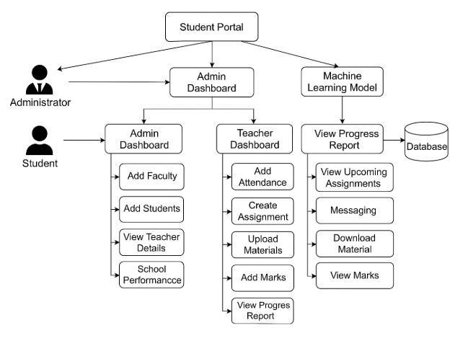
SYSTEM ARCHITECTURE
27 October 2026
Database: Admin, Teacher and Student dashboards connected to the ML model and database.

Slide 15
TECHNIQUES
27 October 2026
Naïve Bayes: a simple method that uses probability to sort students.
XGBoost: a strong method that builds many small decision trees, one after another.
Both models give the result as Good, Fair or Poor.
Their accuracy is compared. XGBoost gives the best accuracy.
Dashboards show the prediction to teachers and students.

Slide 16
DATASETS
27 October 2026
Student records: attendance, assignment scores and subject marks.
Each record is labelled Good, Fair or Poor.
Data is cleaned first: missing values are removed and marks are scaled.
Data is split into training and testing parts, for example 80% and 20%.
New marks entered in the portal are stored in the database.

Slide 17
IMPLEMENTATION
27 October 2026
Web pages give separate dashboards for Admin, Teachers and Students.
The back end handles logins, attendance, assignments, marks and messages.
A database stores all student and teacher records.
The ML model is trained on student marks and called by the portal.
Predictions and feedback show on the student dashboard.
Parents get updates by email.

Slide 18
RESULTS
27 October 2026
Expected Results
One portal for Admin, Teachers and Students.
Instant feedback on student performance.
Easy messaging and study material sharing.
Weak students can be found early.
Evaluation Criteria
How accurate Naïve Bayes and XGBoost are (XGBoost is better).
Correct Good / Fair / Poor results.
All features work properly.
Expected Outcome
Student Marks + ML → Feedback & Early Help

Slide 19
CONCLUSION
27 October 2026
The portal manages academic work in one place.
It has simple dashboards for Admin, Teachers and Students.
Machine learning predicts student performance from marks.
XGBoost gives the best accuracy.
Teachers can help weak students early.
Less manual work and better communication.

Slide 20
REFERENCE
27 October 2026
Lau, W., & Abdul Rahman, H. (2026).
Predicting academic performance through machine learning: integrating demographic, psychological, and behavioral predictors using explainable AI.
Asia Pacific Education Review. doi: 10.1007/s12564-026-10124-y.
2) Kate, C., Srinivas, T. A. S., Asim, Md., Kumar, M. S., Narayanrao, P. V., & Sasi, S. (2026).
EduBoost: A High-Accuracy XGBoost Framework for Student Academic Performance Prediction.
ITEGAM-JETIA, vol. 12, no. 59, pp. 884–894. doi: 10.5935/jetia.v12i59.3734.
3) Nasril, Syariyanti, A. B., & Maulidia, N. A. (2026).
Classification of Timely Student Graduation Rates Based on Academic Data Using Naïve Bayes.
Journal SENSI, vol. 12, no. 2, pp. 175–180. doi: 10.33050/sensi.v12i2.4531.
4) Latifah, S., Martanto, Dana, R. D., Dikananda, F., & Hayati, U. (2026).
Predicting Student Academic Performance Based on Learning Habits Using XGBoost and SHAP.
Journal of Artificial Intelligence and Engineering Applications, vol. 5, no. 2.
Project Abstract:
A Web-Based Student and Teacher Portal for Academic Management.
Batch A19, Department of Information Technology.

Slide 21



27 October 2026

